Slide 1
Introduction to the Sailboat Racing Rules
Some portions taken from -
Peter Winkelstein
Revised 6/17/2011
Copyright 2005, 2006, 2011 Peter Winkelstein
Permission is granted to reproduce freely with the condition that this slide is duplicated in its entirety

Slide 2
Assumptions
You intend to use these rules as a shield, not a sword
  Meaning, you want to keep out of trouble and still win races
  Ignorance of the rules can make a sailor overly timid
  Ignorance of the rules can make a sailor dangerous
You do not intend to match race, team race, or do anything weird like that without further study of the rules
All Captains are expected to learn and understand the rules of racing. Attendance of a basic rules class does NOT exonerate you from this responsibility.
Notes:
2

Slide 3
Overview
Starting Sequence
Basic rules everyone should know
Passing situations
Meeting situations
Mark roundings
Obstructions
Basic Review
Local Rules & Procedures

Slide 4
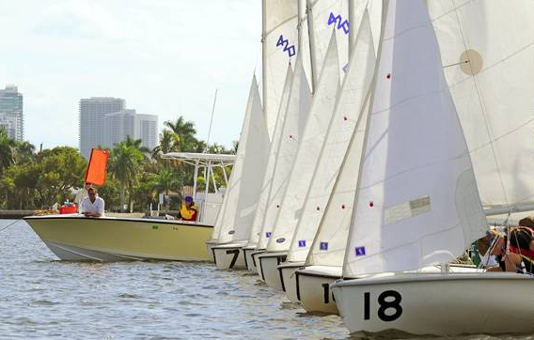
Starting Sequence
Starting sequence
  Flags
  Horns
  Timing
Other flags

Slide 5

Before Sequence
wind
RC

Slide 6
2 Minutes Prior **
wind
Honk!
RC
Honk!

Slide 7

Warning Signal
The warning signal is 5 minutes prior to the first start. A class flag is displayed.
wind
Horn!
RC
Notes:
7

Slide 8


Preparatory Signal
Preparatory signal is 4 minutes prior to start. A blue & white flag is raised (with class flag).
wind
Horn!
RC
Notes:
8

Slide 9
One Minute
At one minute before the first start, the preparatory flag is lowered.
wind
Horn!
RC
Notes:
9

Slide 10
Start
Start signal is the lowering of the Class flag.
wind
Horn!
RC
Notes:
10

Slide 11

Starting Sequence Summary
Starting Sequence
Class Flags (CF)
Time
Flags
Sound
Warning
5
CF
1 Sound
One
Preparatory
4
CF
1 Sound
Warning
One Minute
1
CF
1 Sound Long
Two
Start
0
CF
1 Sound

Slide 12




Other Flags
Flag Horn
Flag Horn
Individual Recall
Race is Abandoned
General Recall
Course has been shortened
Postponed

Slide 13

Individual Recall
The RC will raise the X flag if a boat is over the line at the start.
Horn!
wind
You’re over!
RC
Notes:
13

Slide 14
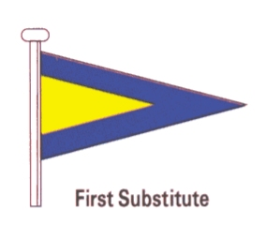
General Recall
The RC may signal a general recall if many boats are over the line at the start.
wind
Horn!
Horn!
RC
Notes:
14

Slide 15
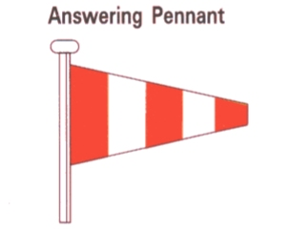
Postpone
The RC may postpone the race for lack of wind, changing wind direction, etc.
Horn!
Horn!
No wind!
RC
Notes:
15

Slide 16
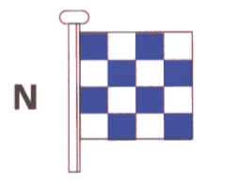
Abandon the Race
The RC may abandon the race for lack of wind, storms, etc.
Horn!
Horn!
Horn!
No wind!
RC
Notes:
16

Slide 17
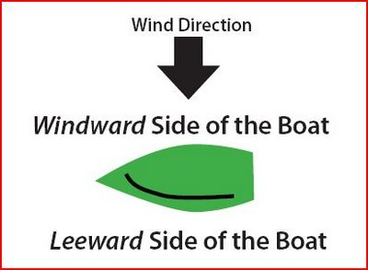
Review: Windward - Leeward

Slide 18


Review: Starboard - Port Tack
Wind Direction
Starboard Tack
Port Tack
Wind coming over the starboard (right) side of boat. Sails on port (left) side.
Wind coming over the port (left) side of boat. Sails on starboard (right) side.

Slide 19
Basic right-of-way rules
Basic rules everyone should know
Starboard tack/port tack
Windward/leeward
Overtaking
Rounding jibe or leeward marks
Don't hit other boats, even if you have the right-of-way!

Slide 20
Basic Responsibilities
“Competitors in the sport of sailing are governed by a body of rules that they are expected to follow and enforce. A fundamental principle of sportsmanship is that when competitors break a rule they will promptly take a penalty, which may be to retire.” – Sportsmanship and the Rules
“A boat shall avoid contact with another boat if reasonably possible. However, a right-of-way boat or one entitled to room or mark-room
(a) need not act to avoid contact until it is clear that the other boat is not keeping clear or giving room or mark-room, and
(b) shall be exonerated if she breaks this rule and the contact does not cause damage or injury.” – Rule 14
Notes:
20

Slide 21
The Fundamental Concepts
“A boat keeps clear of a right-of-way boat … if the right-of-way boat can sail her course without need to take avoiding action …” – Definition Keep Clear
To say that Boat A has “right of way” over boat B is exactly the same as saying B must keep clear of A.
Room is “the space a boat needs … [to] maneuver promptly in a seamanlike way” – definition Room
First, decide who has right of way. Then decide whether she might need to give the other boat room.
Notes:
21

Slide 22
Basic Rules 1 – Opposite Tacks
A boat on starboard tack has right of way over a port tack boat
wind
Starboard!

Slide 23
On Opposite Tacks
“When boats are on opposite tacks, a port-tack boat shall keep clear of a starboard-tack boat.” – rule 10
Generally, a boat is on the tack opposite to the side on which her boom lies.
Always start your rules analysis with “What tack am I on? What tack is the other boat on?”
Notes:
23

Slide 24
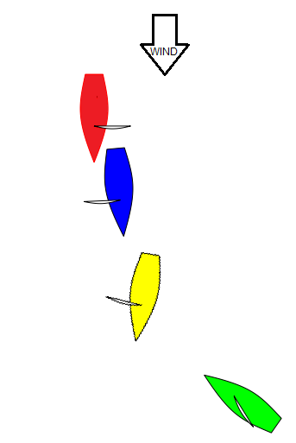
Who's on Starboard Tack?
Answer: Red and Green. Blue and Yellow must keep clear of Red and Green!
Notes:
24

Slide 25
Basic Rules 2 – Same Tack
A boat to leeward has right of way over a windward boat on the same tack
wind

Slide 26
Basic Rules 3
When rounding a windward mark, an inside boat on the same tack must be given room
wind
mark
Room!

Slide 27
Basic Rules 4
When rounding a leeward mark, an inside boat must always be given room
wind
Room!
mark

Slide 28
Basic Rules 5
A boat which is tacking must keep clear of one that is not
A boat clear astern must keep clear of boat ahead
When a right-of-way boat changes course, she must give other boats room to keep clear

Slide 29
Basic Rules 6
What do I do if I break a rule?
  If you break a right-of-way rule, you must do two turns promptly after the incident
  If you touch a mark, you must do one turn promptly
  If there was serious damage, you must retire
  You must keep clear of other boats when doing your penalty turns

Slide 30
Passing Situations 1
A boat passing to windward must keep clear of a leeward boat on the same tack. The leeward boat may luff to prevent the pass.
wind
Head up!

Slide 31
Passing Situations 2
A boat passing to leeward on the same tack must not sail above her proper course
wind
Proper course!

Slide 32
On the Same Tack
“When boats are on the same tack and overlapped, a windward boat shall keep clear of a leeward boat” – rule 11
“When boats are on the same tack and not overlapped, a boat clear astern shall keep clear of a boat clear ahead” – rule 12
Remember, these rules only apply when the boats are on the same tack. Otherwise, port must keep clear of starboard.
Notes:
32

Slide 33
Clear Astern; Clear Ahead; Overlapped
“One boat is clear astern of another when [she is] behind a line abeam from the [stern of] the other boat. The other boat is clear ahead. They overlap when neither is clear astern. However, they also overlap when a boat between them overlaps both.
“These terms always apply to boats on the same tack. They do not apply to boats on opposite tacks unless rule 18 applies or both boats are sailing more than ninety degrees from the true wind.” -- Definitions
Notes:
33

Slide 34
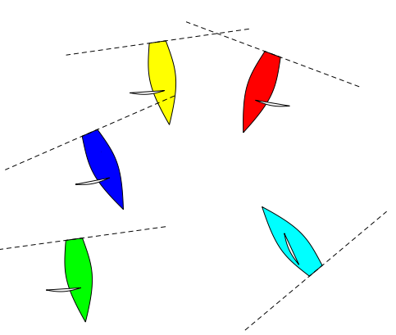
Which boats are overlapped?
Answers: Red, Yellow, Blue are all overlapped with each other; Green is clear ahead of them. Light Blue is overlapped with Red only. The terms do not apply between her and the others.
Notes:
34

Slide 35
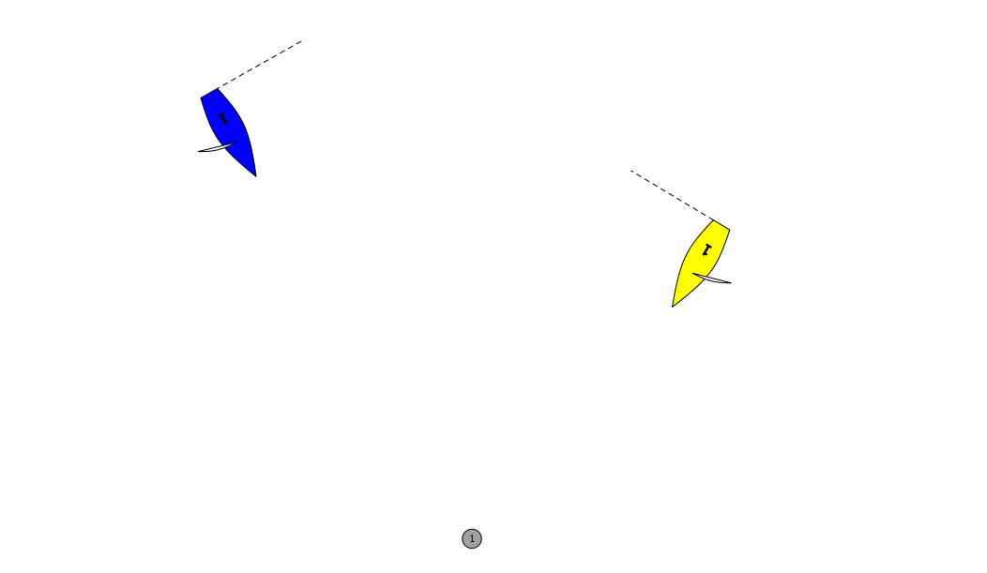
Overlap Tip
Boats sailing downwind on very different courses are generally overlapped.
Yellow and Blue are overlapped even though Yellow is clearly “ahead” of Blue in the race.
Notes:
35

Slide 36
Passing Situations 3
On an offwind leg, a boat being passed to leeward on the same tack must not sail below her proper course
wind
Proper course!

Slide 37
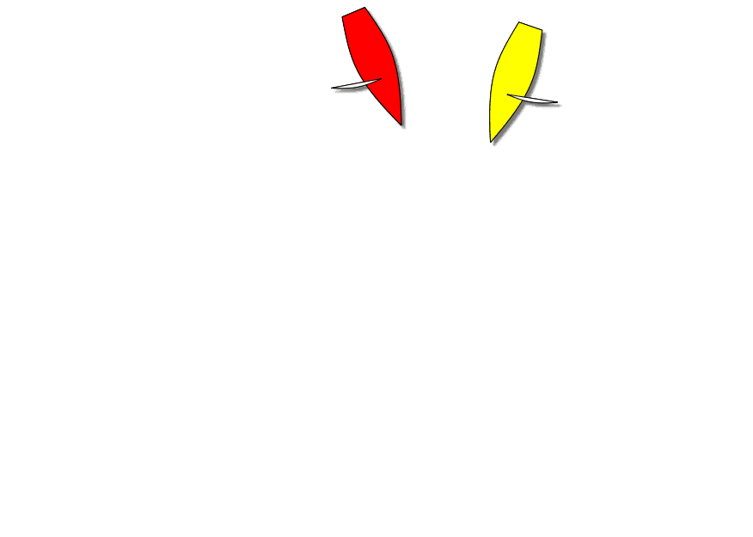
Implications Offwind
Until she jibes, Yellow has right of way and Red must keep clear. Red fails to do so, and should now take a penalty.
Notes:
37

Slide 38
Passing Situations 4
Before the start, there is no proper course, so a boat passing to leeward may luff a windward boat up to head-to-wind
Once the start gun sounds, a boat passing to leeward may not sail above her proper course (close hauled)

Slide 39
Meeting Situations 1
A boat on starboard tack has right of way over a port tack boat
wind
Starboard!

Slide 40

Tacking Too Close
“After a boat passes head to wind, she shall keep clear of other boats until she is on a close-hauled course. ...” – rule 13
Note that it's the new course of the tacking boat that matters,
not whether she has trimmed her sheets.
Notes:
40

Slide 41
Restrictions on Right of Way
When a boat acquires right of way, she shall initially give the other boat room to keep clear, unless she acquires right of way because of the other boat’s actions. (rule 15)
When a right-of-way boat changes course, she shall give the other boat room to keep clear. (rule 16.1)
Notes:
41

Slide 42
Meeting Situations 2
Tack (and windward/leeward) is defined by which side the boom is on
wind
leeward
windward
port
starboard

Slide 43
Meeting Situations 3
A right-of-way boat must give a keep-clear boat room to keep clear
A starboard tack boat must not change course if as a result the port tack boat must immediately change course to keep clear (i.e. no hunting)

Slide 44
Leeward Overlap from Clear Astern After the Start
“If a boat clear astern becomes overlapped … to leeward of a boat on the same tack within two hull lengths, she shall not sail above her proper course while they remain on the same tack and overlapped …” (rule 17)
Proper Course is “A course a boat would sail to finish as soon as possible in the absence of the other boats referred to in the rule using the term. A boat has no proper course before her starting signal.” -- definition
Note that it’s the leeward boat’s proper course that matters, not the windward boat’s.

Slide 45
Rule 17 – On the Same Tack;
Proper Course
Rule 17 is about limiting where a leeward boat can sail when near a keep-clear boat. Rule 17 simply puts a “limit” on where a leeward boat can sail when near a windward boat in certain situations. It does not shift any right of way to the windward boat.

Slide 46
Rule 17 – On the Same Tack;
Proper Course
The concept of rule 17 is simple:
Either L is “limited” to sailing no higher than her proper course or she is “free” to sail up to head to wind if she pleases. It is either one or the other for L whenever L and W are overlapped on the same tack and within 2 of L’s lengths of each other.

Slide 47
Rule 17 – Simplified
The only time L is “limited” is when she is on the same tack as W and becomes overlapped to leeward of W from clear astern within 2 of her lengths of W.
That’s it! The “limit” does not apply when:
L overlaps W when more than 2 lengths apart
or when W becomes overlapped to windward
or when L becomes overlapped to leeward of W on the opposite tack then gybes.

Slide 48
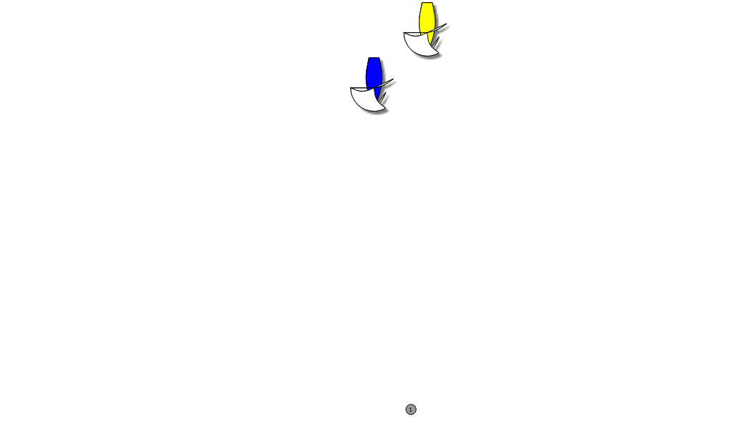
An Illegal Luff
Assume this is Yellow’s
Proper Course

Slide 49



Wind
Assume Blue’s
Proper Course
Legal Luff?

Slide 50
Wind
Assume Blue’s
Proper Course
Legal Luff?

Slide 51

Wind
Assume Blue’s
Proper Course
Legal Luff?

Slide 52
Mark Roundings 1
At a windward mark, a boat on starboard tack has right of way over a port tack boat
wind
mark
Starboard!

Slide 53
Mark Roundings 2
wind
When rounding a windward mark, an inside boat on the same tack must be given room if overlapped within three boat lengths of the mark
mark
Room!

Slide 54
Mark Roundings 3
wind
When rounding a leeward mark, an inside boat (if overlapped within three boat lengths of the mark) must always be given room
Room!
mark

Slide 55
Mark-Room
“Mark-Room Room for a boat to leave a mark on the required side. Also,
    (a) room to sail to the mark …, and
    (b) room to round the mark as necessary to sail the course.” -- definition
“If boats are overlapped when the first of them reaches the zone, the outside boat at that moment shall thereafter give the inside boat mark-room. If a boat is clear ahead when she reaches the zone, the boat clear astern at that moment shall thereafter give her mark-room.” (rule 18.2(b))
“When a boat is required to give mark-room by rule 18.2(b), … she shall continue to do so even if later an overlap is broken or a new overlap begins” (rule 18.2(c))
This rule does not apply:
  At a starting mark surrounded by navigable water (Preamble, Section C of Part 2)
  When the boats are on opposite tacks on a beat to windward; (rule 18.1)
  Between a boat approaching the mark and one leaving it; (rule 18.1)

Slide 56
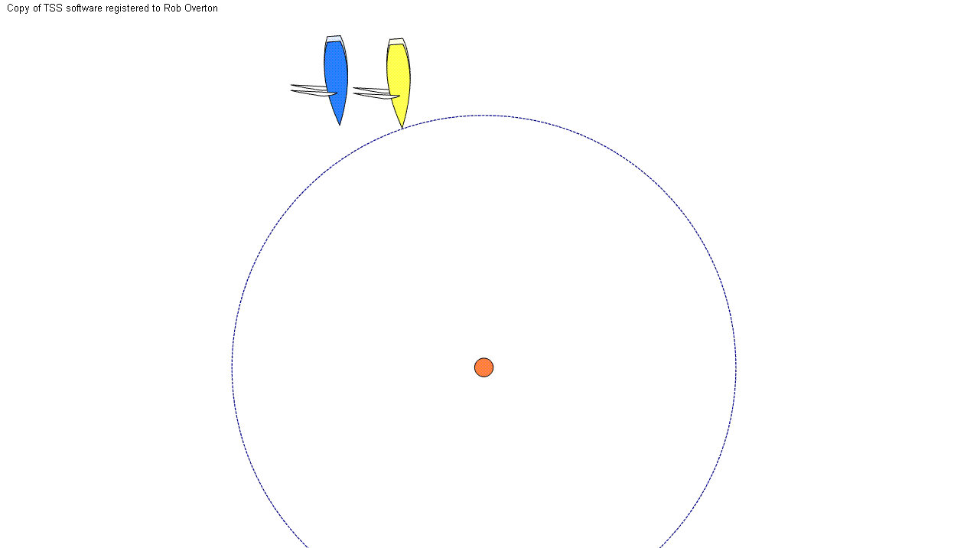
Mark-Room at Leeward Mark
Yellow has mark-room but must keep clear of Blue. She is entitled to sail to the mark and round it. She is unable to sail close enough to the mark to prevent Blue from going between her and the mark. No rule is broken here.

Slide 57
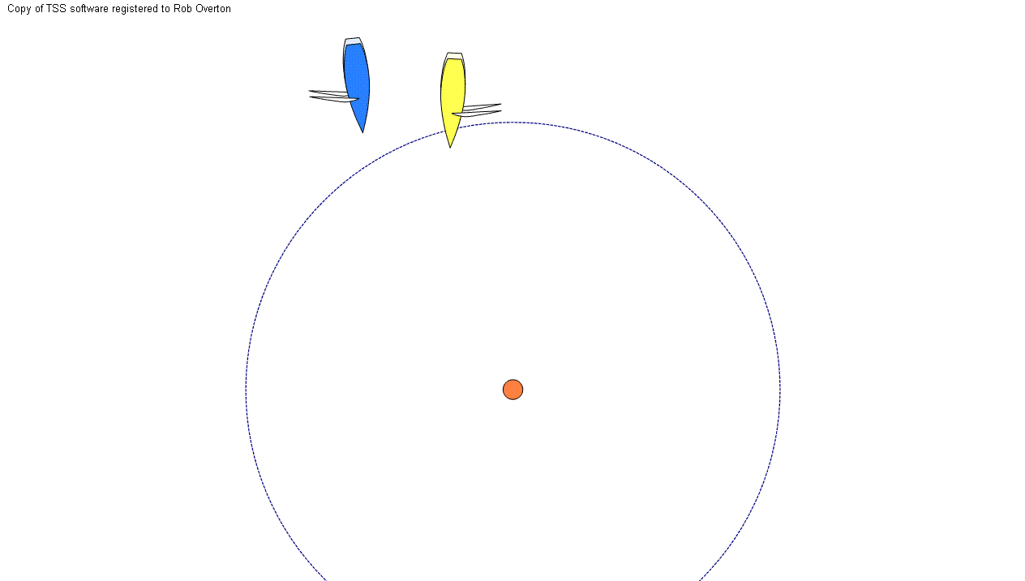
Right of Way at Leeward Mark
In addition to having mark-room, Yellow has right of way. She can make a wider, faster turn that brings her closer to the mark at the end.

Slide 58
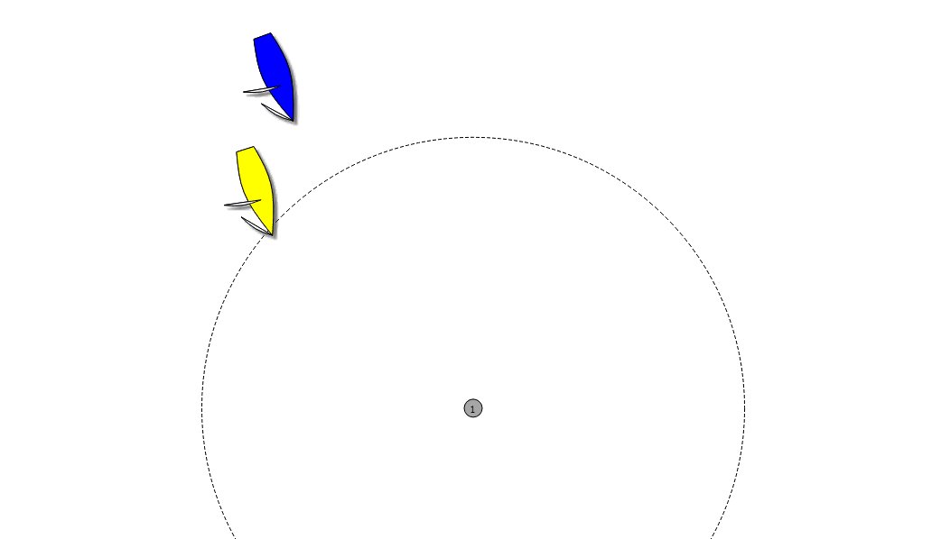
Clear Ahead at the Zone
Yellow is clear ahead at the zone, with right of way. She swings wide and then “closes the door” on Blue. Blue fails to keep clear and should take a penalty.

Slide 59
Rules 18.3 and 18.4 – Limitations on Behavior
“If a boat in the zone passes head to wind and is then on the same tack as a boat that is fetching the mark, rule 18.2 does not thereafter apply between them. The boat that changed tack
    shall not cause the other boat to sail above close-hauled to avoid contact or prevent the other boat from passing the mark on the required side, and
    shall give mark-room if the other boat becomes overlapped inside her.
(rule 18.3)
“When an inside overlapped right-of-way boat must gybe at a mark to sail her proper course, until she gybes she shall sail no farther from the mark than needed to sail that course. Rule 18.4 does not apply at a gate mark.” (rule 18.4)

Slide 60
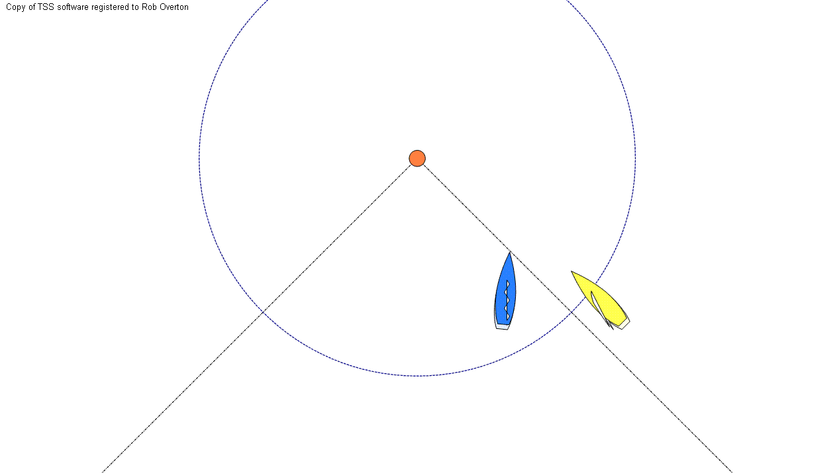
Rule 18.3 Scenario

Slide 61
Mark Roundings 4
An inside boat is not entitled to room at a start mark
wind
mark
RC
Barging!

Slide 62
Obstructions
“Obstruction An object that a boat could not pass without changing course substantially, if she were sailing directly towards it and one of her hull lengths from it. … [Also, a boat racing that boats] are required to keep clear of.”
“A right-of-way boat may choose to pass an obstruction on either side. … When boats are overlapped, the outside boat shall give the inside boat room between her and the obstruction, unless she has been unable to do so from the time the overlap began.” (rule 19.2)

Slide 63
Room to Tack (Rule 20)
When beating to windward, a boat may hail a boat to windward of her for room to tack.
The other boat must either tack as soon as possible or hail “You tack!”
If the hailed boat has another boat to windward of her, she may hail that boat for room to tack.
After the hailed boat responds, the hailing boat must tack immediately.
If the hailed boat replied “You tack!” she must give the hailing boat room to clear her.
This rule does not apply at committee boats that are starting marks.

Slide 64
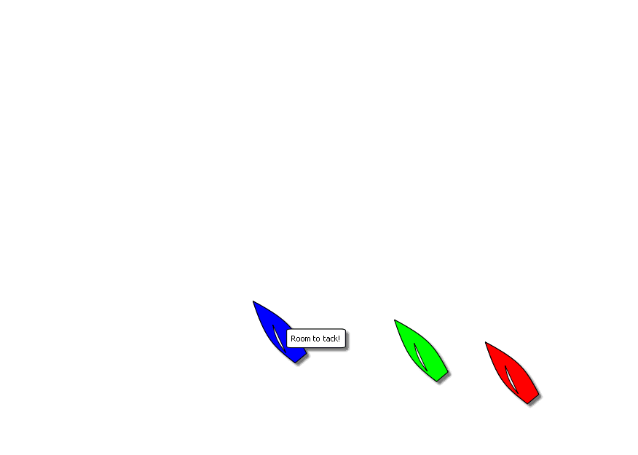
Hailing for Room to Tack

Slide 65
Penalties
Hitting a Mark = One Turn Penalty (rule 31)
All Others = Two Turn Penalty (part 2)
If both occur during the same incident – i.e. fouling while rounding a mark – You do not need to take the penalty for rule 31. 2 turns only.

Slide 66
Penalties
If the boat caused injury or serious damage or, despite taking a penalty gained a significant advantage in the race or series by her breach her penalty shall be to retire.

Slide 67
Penalties – Taking your Turns
You must take your turns as soon as possible after the incident – Not halfway down the course.
After getting well clear of other boats you must start your turns promptly.
A “Turn” is defined as a tack and a gybe in the same direction.

Slide 68
Penalties – Taking your Turns
A two turn penalty would consist of two tacks and two gybes in the same direction.
When all of the tacks and gybes are complete the penalty is complete.
You will need to do one turn immediately after the other.

Slide 69
General Summary of Rules
Starboard has right of way over port—this rule takes care of 90% of problems - port keeps clear of starboard.
Windward keeps clear of leeward
The boat astern keeps clear of the boat ahead.
A boat tacking keeps clear of one that is not.
Avoid collisions - When in doubt, keep clear of other boats (you are never in the right if there is a major collision!)
If you gain right of way or change course, give the other boat time to keep clear.
The inside boat(s) at three boat lengths from the mark is entitled to room to round the mark, if overlapped.
If you have violated one, take a penalty -We all have to do penalty turns now and again

Slide 70
For Simplicity
1. Don't hit other boats. Collisions are slow and arguments are slower.
2. Port tack boat usually has to stay out of the way of everyone else.
3. Windward boats must stay away from leeward boats.
4. The inside boat gets to go around the mark first.
5. Don't hit marks. Doing circles is slow.
6. Don't hit the committee boat. First, it is a mark and second, it really makes them mad.

Slide 71
Local Rules - Discussion
Captains will have the responsibility to check the board for course and race information before leaving the docks.
Tuesday Nights – Start sequence will start promptly at 18:25 with the race starting at 18:30.
Prior to the start sequence, come within hailing of the committee boat and report your crew headcount.
Monitor channel 68 throughout the race.

Slide 72
Local Rules - Continued
During the start sequence you are not allowed to cross the line. Any crossing of the line early requires that you go “around the end” to restart. No dipping.
Races will be called at the published sunset time for that day. Any boats not finished by that time will be recorded as DNF.
Last boat to finish shall stay on the water and wait for the committee boat.

Slide 73
Short Break

Slide 74
Technology - RaceQS
Played with RaceQS last season.
We would like to get all boats to participate this year.
We will need one, ONE ONLY, smart phone per boat to record and upload.
Should allow us to review the race and have some good, post-race, discussions.

Slide 75
Technology - RaceQS
Download the App from your App Store – Search for RaceQs. The app and the account are free.
Setup your account including Boat Name.
Start the app and start recording your track prior to the start sequence.
After the race upload your data – via cell service is easiest.
The race course only needs to be setup once per race, all boats will see the marks and lines. RC will set up marks.

Slide 76
RaceQs Demonstration
RaceQs – Sample race from last fall – Rattler & Wildfire

